Slide 1
Financial Discipleship Orientation Slide Deck Instructions
We have developed a Set Your House In Order Orientation Slide Deck to assist you during your Orientation Session of your study. The use of the slide deck is optional for your use as a FD Leader and/or Co-leader.
In order to customize the slide deck for your session, please do the following:
  Open the PowerPoint Presentation and download a copy on your computer
  Edit the Cover Slide #2 with Month, Day and Year (date of the Orientation)
  Edit Slide #4 – Insert your photo and the Leader/Co-Leader with your name(s) and 3-4 high level bullets
  Edit Slide #46 with date of your first session in the banner of the slide (date & time of 1st Class)
  Edit Slide #48 with each Co-leaders name, email address and phone number
Start your Orientation session on slide #2

Slide 2


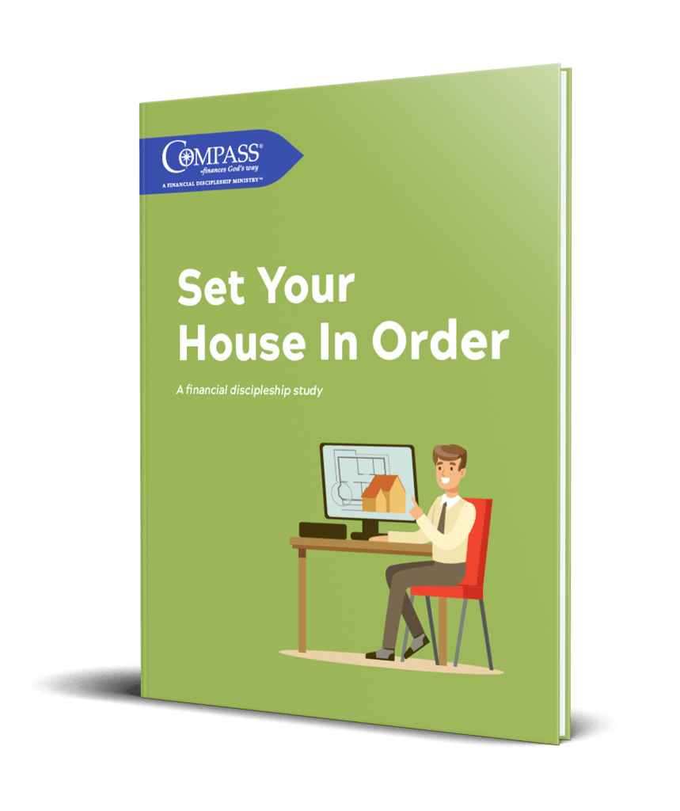
Set Your House in Order
Orientation | Month, Date, Year

Slide 3

Agenda
Prayer, Welcome & Introductions
Introduction Video
Objectives & Features of the Study
Study Demonstration & Tools
How the Study Works
Preparation for Section 1
Closing Prayer
Notes:
Open in prayer and then review the agenda.

Slide 4


Your Leader / Co-Leader
Co-Leader #1 Name
Several bullets that highlights about you
Co-Leader #2 Name
Several bullets that highlights about you
Notes:
Add the leader/co-leaders photos along with several bullets

Slide 5
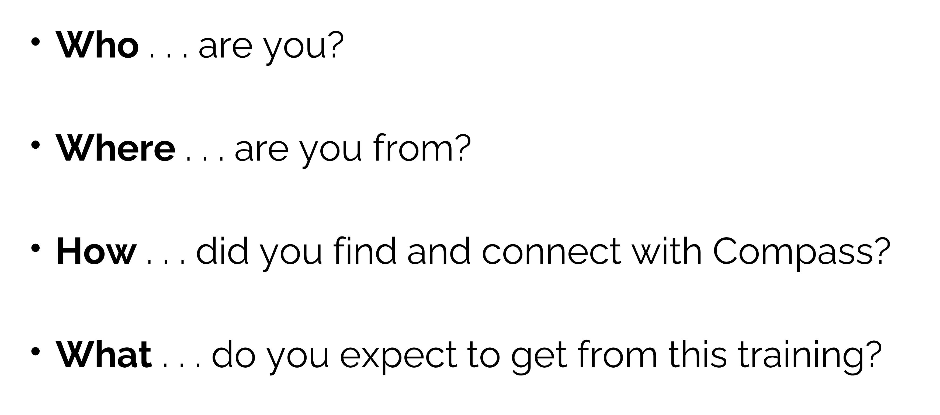
Brief Introductions
Notes:
Start with Co-leaders and then participants.

Slide 6
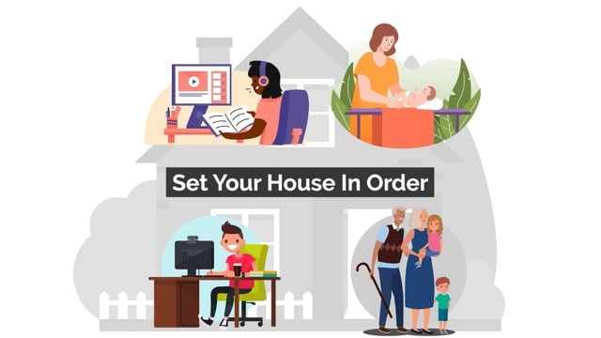
Introduction To Set Your House In Order
Notes:
View video

Slide 7

Set Your House In Order
Purpose & Objectives

Slide 8

Purpose & Objectives
The Set Your House In Order study objective is to assist you in organizing important documents for:
  Yourself and loved ones
  Organizing life insurance
  Establishing a will
  Focus on Generosity
  Identify Advisors to consider (accountant, financial advisor, attorney, banker, insurance agent, etc.),
  Establishing powers of attorney
  Finishing Well
Notes:
Review Purpose & Objectives on the slide

Slide 9

Elements of the Study
Inductive study method
Each Section has three modules
Application worksheets
Financial Discipleship Study companion App – prayer requests
Notes:
Review the Elements of he Study

Slide 10





Inductive Study Method Overview
      Prayer - Ask for guidance
      Scripture reading
      Observation - What does the text say?
      Interpretation - What does the text mean?
      Application - How do I apply the text?
Notes:
Review the parts of the Inductive Study Method

Slide 11
Set Your House In Order
Features & Demonstration

Slide 12

Features of Financial Discipleship Study
Daily homework may take 30 minutes +/- to complete
Consider using the homework as a daily devotional opportunity
Notes:
Review the Features and point out that it may take 30 plus minutes.

Slide 13
Set Your House In Order Study Format
Six Sections - each section has three modules
  Inductive Bible Study
  Howard’s Highlights
Notes:
Review the section format of the study.

Slide 14
Set Your House In Order Study Content
Section 3 – Income & Investments
Module 1 – Eliminating Debt
Module 2 – Future Income
Module 3 – Investments
Section 1 – Starting Well
Module 1 – Preparing & Planning
Module 2 – Your Circle of Trust
Module 3 – God’s Stuff
Section 2 – Assets & Accounts
Module 1 – A Faithful Steward
Module 2 – Pay Up!
Module 3 – Preparing for Challenges
Notes:
Review the first three sections and three modules of the study.

Slide 15
Set Your House In Order Study Content
Section 6 – Finishing Well
Module 1 – Family Mission Statement
Module 2 – Leaving a Spiritual Legacy
Module 3 – The Finishing Well Reunion
Section 4 – Life & Death
Module 1 – Insurance
Module 2 – Health Care Decisions
Module 3 – Going Home
Section 5 –Can’t Take It With You
Module 1 – Near & Dear To You
Module 2 – Generosity
Module 3 – Estate Planning
Notes:
Review the next three sections and three modules of the study.

Slide 16
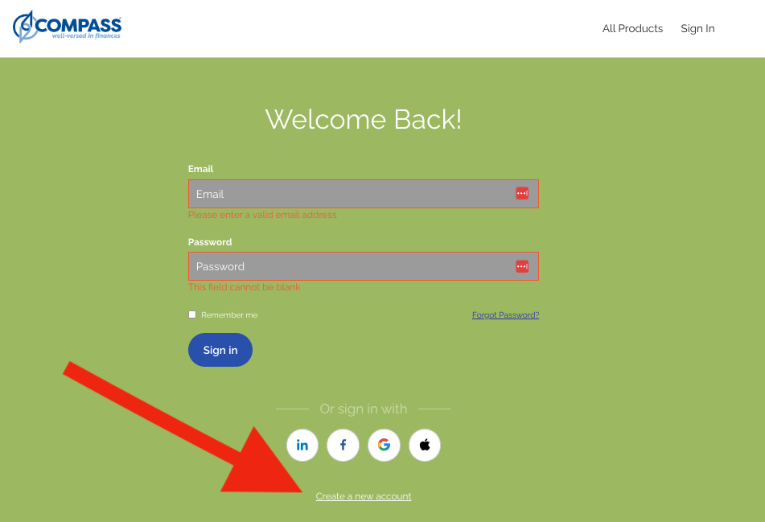
Compass eBooks – Create an Account
Notes:
Click on create an account.

Slide 17
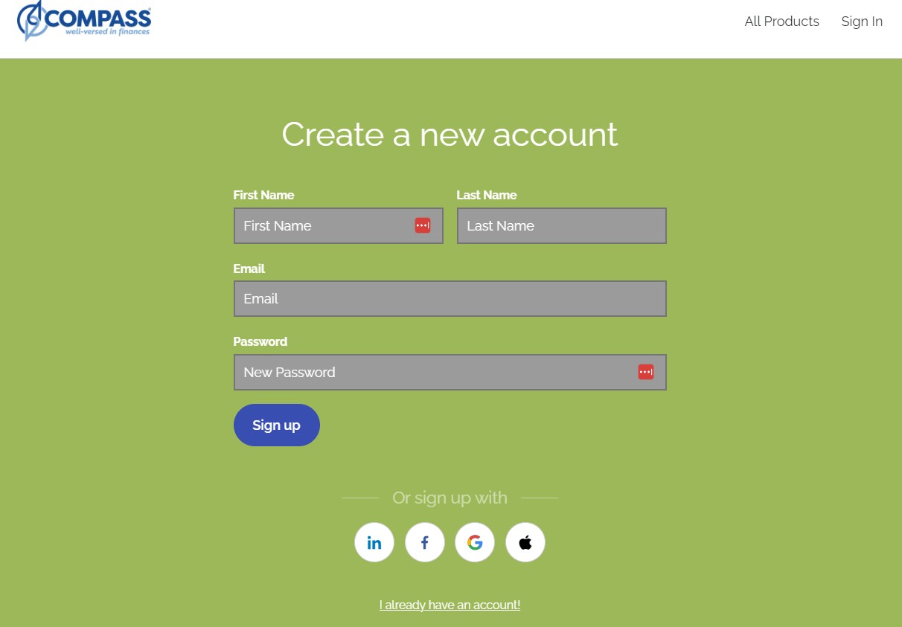
Compass eBooks – Create an Account
Notes:
Create an account by entering your first and last name, email address and password. Click on sign up.

Slide 18
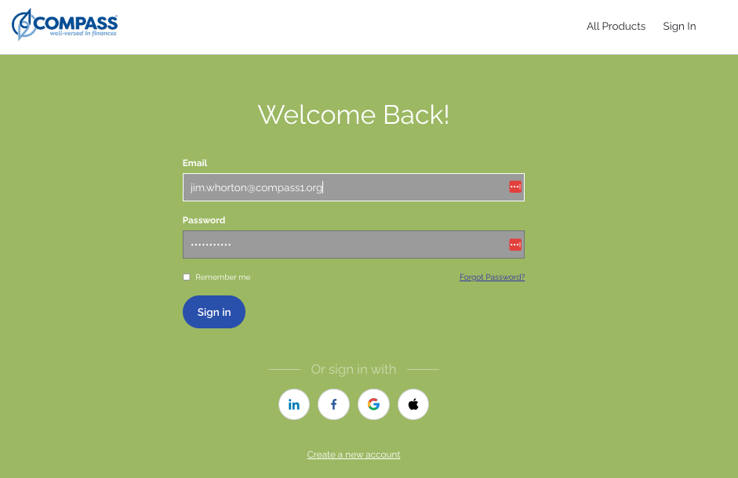
Compass eBooks – Sign In
Notes:
Enter your email and password and click sign in.

Slide 19
Using the eBook Option

Slide 20
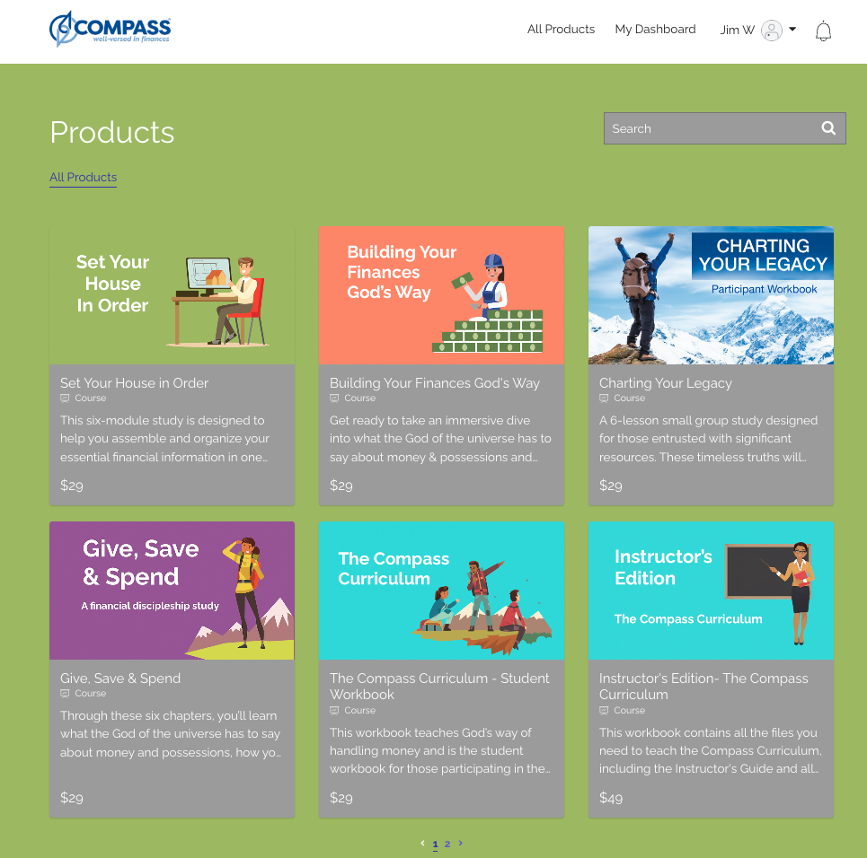
Compass eBooks – Home Screen
Notes:
Click on the $29 to purchase the eBook.

Slide 21

Compass eBooks – Home Screen
Notes:
Click on the $29 to purchase the SYHIO eBook.

Slide 22
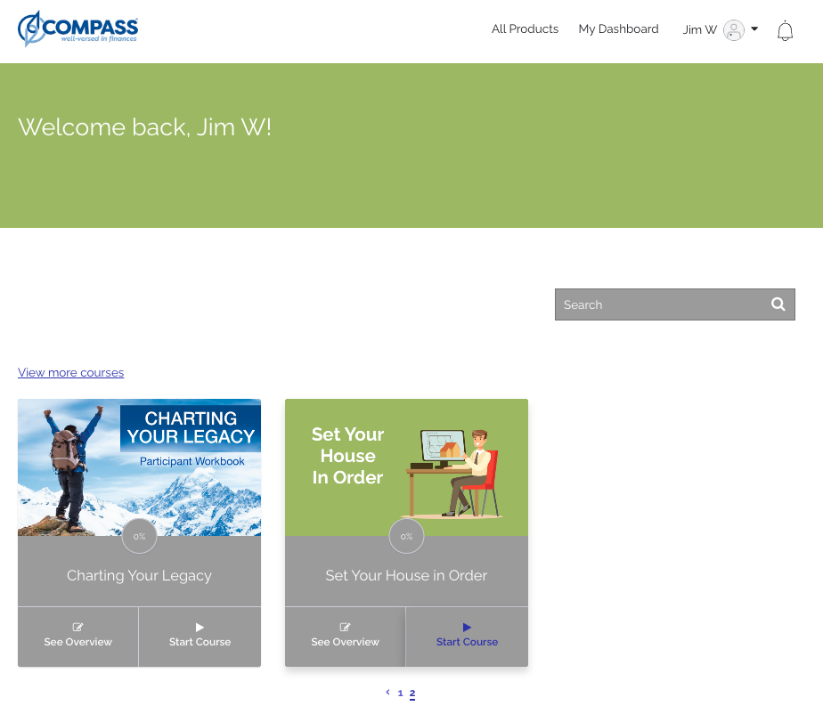
Compass eBooks – Library
Notes:
You will be taken to your personal library listing each of the ebooks that you have purchased. Click on Start Course to begin.

Slide 23
Actual Study Demonstration
Set Your House In Order
Section 2 Overview
Module 2.1 Homework
Prayer Logs
From Compassebooks.org
Notes:
Demonstration of SYHIO – Section 2, Module 2.1 Homework and Prayer Logs.

Slide 24
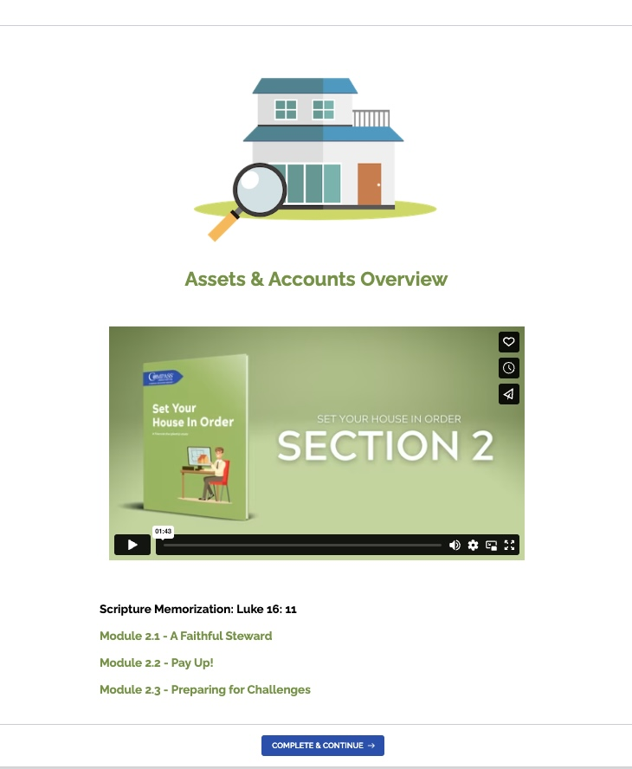
Actual Study Demonstration
Notes:
This is Section 2 and the associated modules

Slide 25
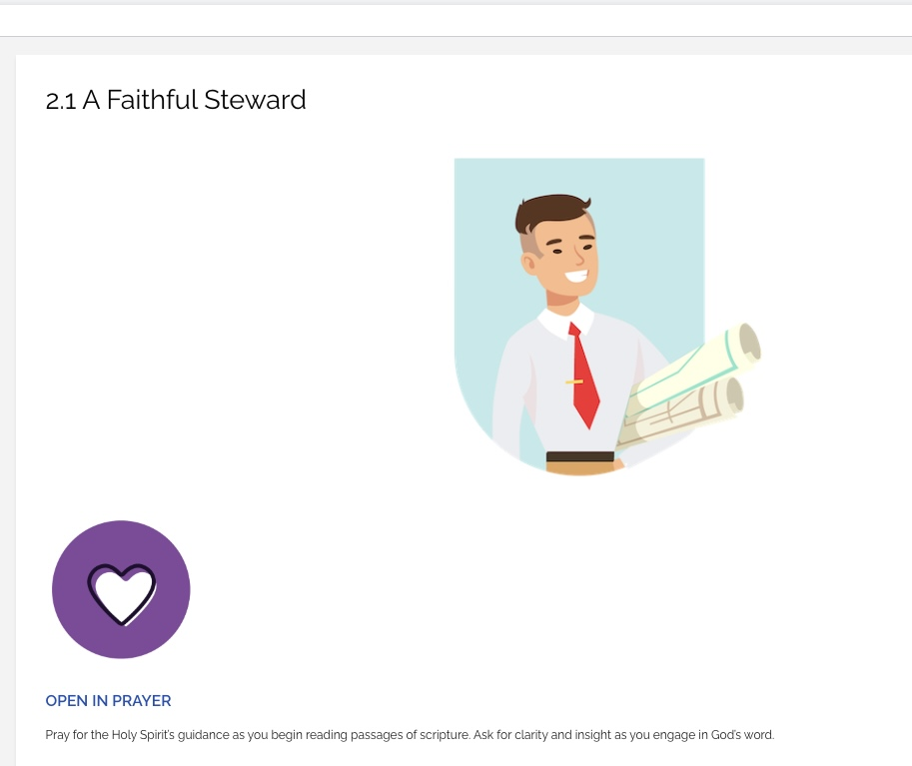
Actual Study Demonstration –
Open in Prayer
Notes:
Always begin your homework with prayer!

Slide 26
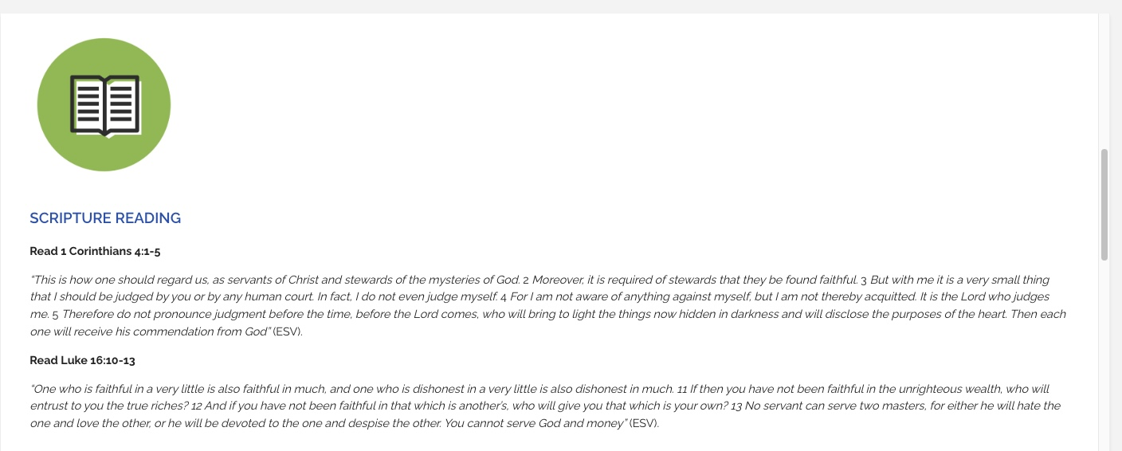
Actual Study Demonstration –
Scripture Reading
Notes:
Read the scripture verse(s).

Slide 27
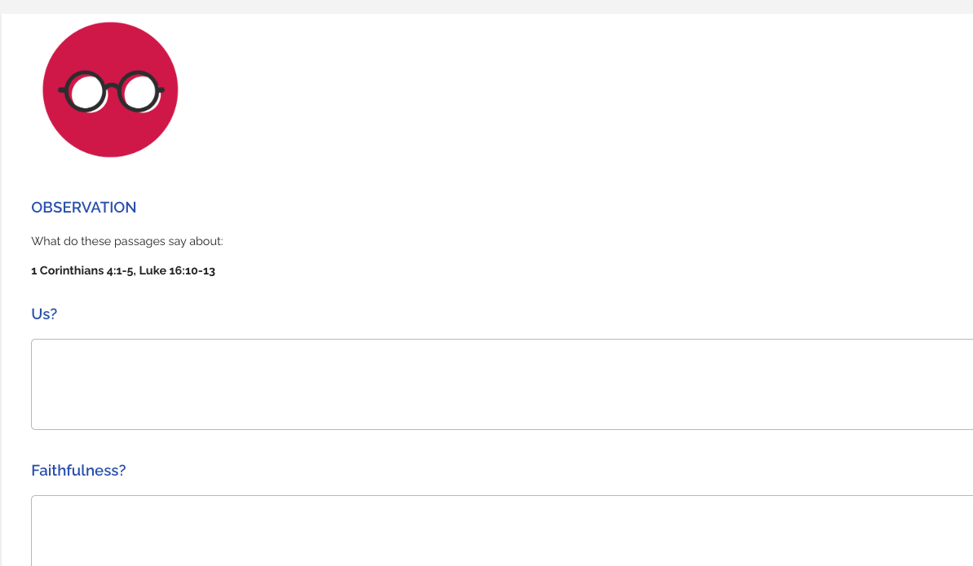
Actual Study Demonstration
Notes:
Answer the Observation questions based upon the scripture verse(s).

Slide 28

Actual Study Demonstration - Observation
Observation section
  Each participant will read all of their responses under Observation
  The next participant will read their responses and continue until everyone has read their answers
  Move to Interpretation
NOTE:
This process is critical in order to finish the study on time
Notes:
This is how we will handle the Observation questions being answered during the weekly sessions.

Slide 29
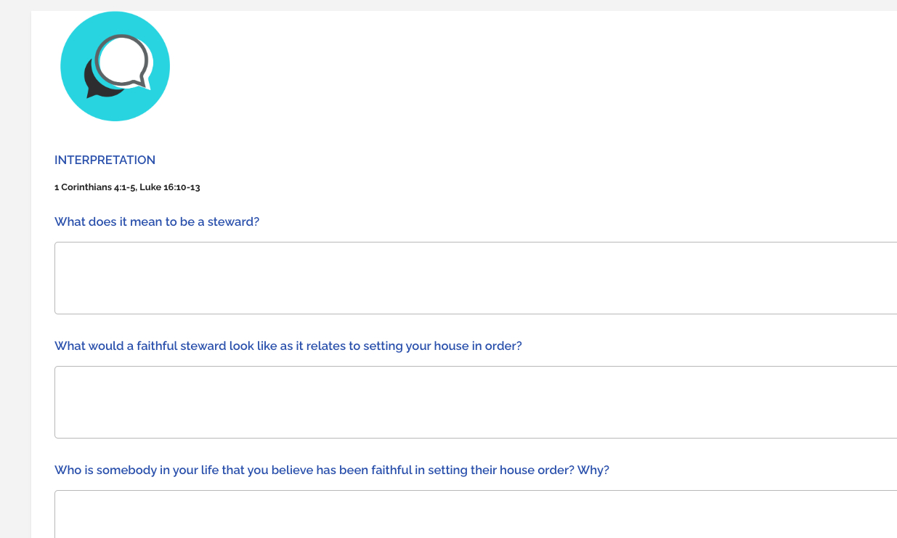
Actual Study Demonstration
Notes:
Answer the Interpretation questions based upon the scripture verse(s).

Slide 30
Actual Study Demonstration - Interpretation
Interpretation section
  Each participant will read all of their responses under Interpretation
  The next participant will read their responses and continue until everyone has read their answers
  Move to Application
NOTE:
This process is critical in order to finish the study on time
Notes:
This is how we will handle the Interpretation questions being answered during the weekly sessions.

Slide 31
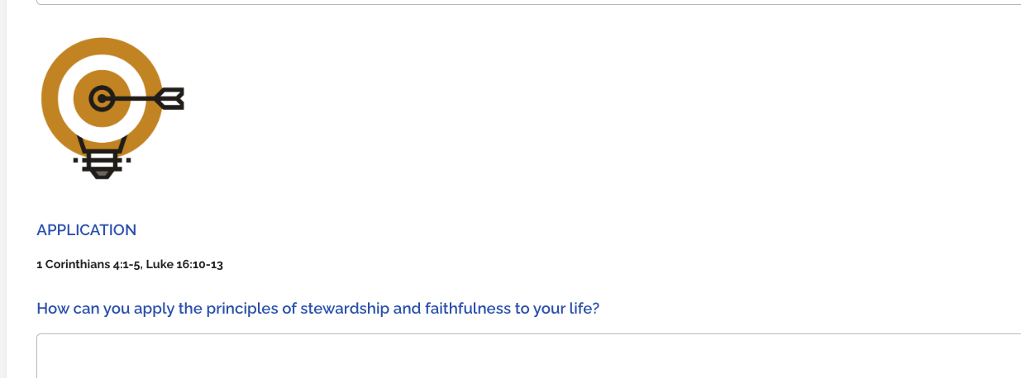
Actual Study Demonstration
Notes:
Answer the questions based upon the scripture verse(s).

Slide 32
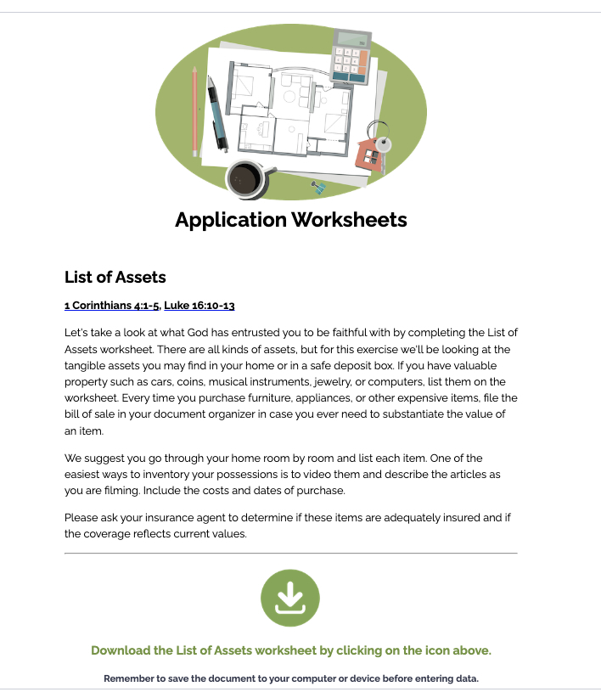
Actual Study Demonstration
Notes:
Download the Application Worksheet by clicking on the green download arrow.

Slide 33
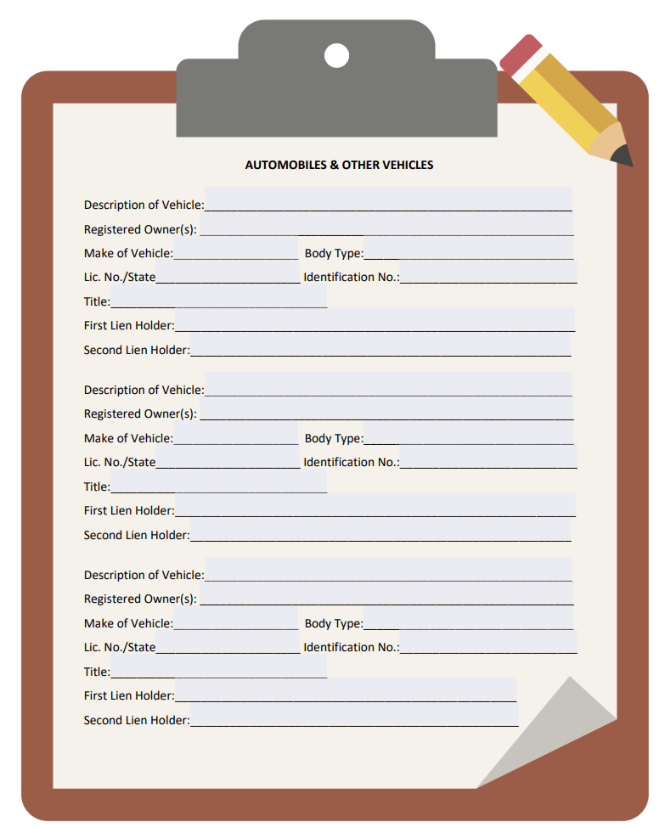
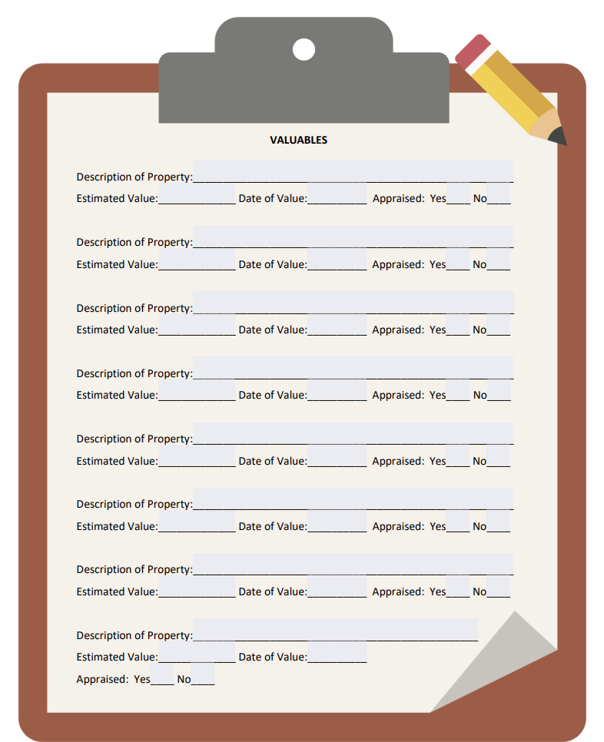
Actual Study Demonstration –
Application Worksheet
Notes:
Complete he Application Worksheets – These will not be shared with anyone in study. These are for your personal review and use.

Slide 34
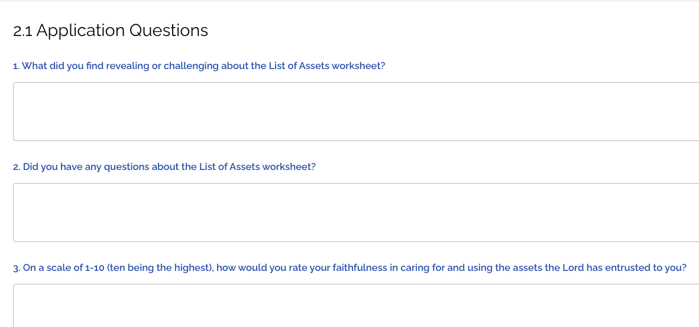
Actual Study Demonstration –
Application Questions
Notes:
Answer the questions based upon the Application Worksheet.

Slide 35
Actual Study Demonstration - Application
Application section
  Each participant will read all of their responses under Application
  The next participant will read their responses and continue until everyone has read their answers
  Move to the next day
NOTE:
This process is critical in order to finish the study on time
Notes:
This is how we will handle the Application questions during the weekly sessions. After this section we move to the next day’s homework.

Slide 36
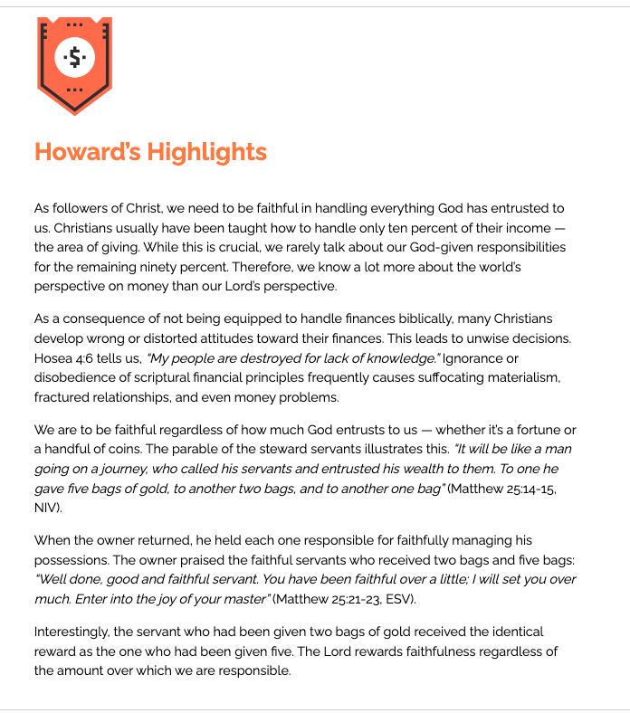
Actual Study Demonstration -
Howard’s Highlights
Notes:
Review the insights offered in Howard’s Highlights.

Slide 37
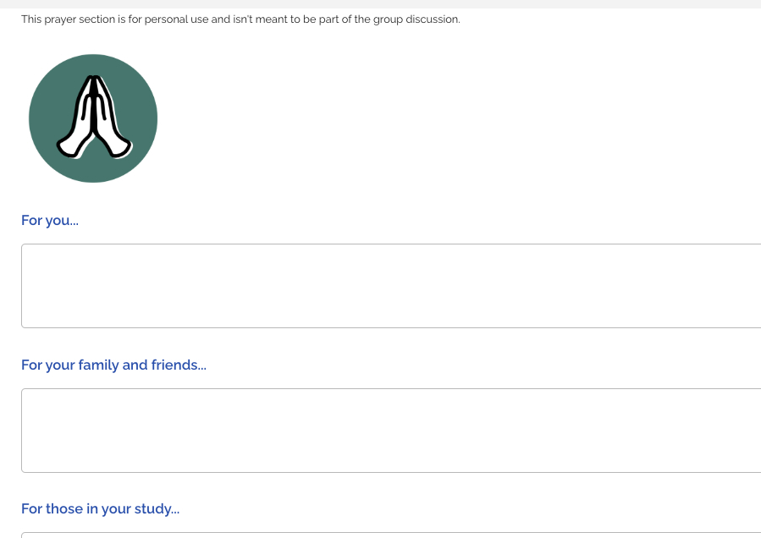
Actual Study Demonstration –
Individual Module Prayers
Notes:
Use this section to capture your personal/individual prayers for yourself, family/friends and others in the study.

Slide 38
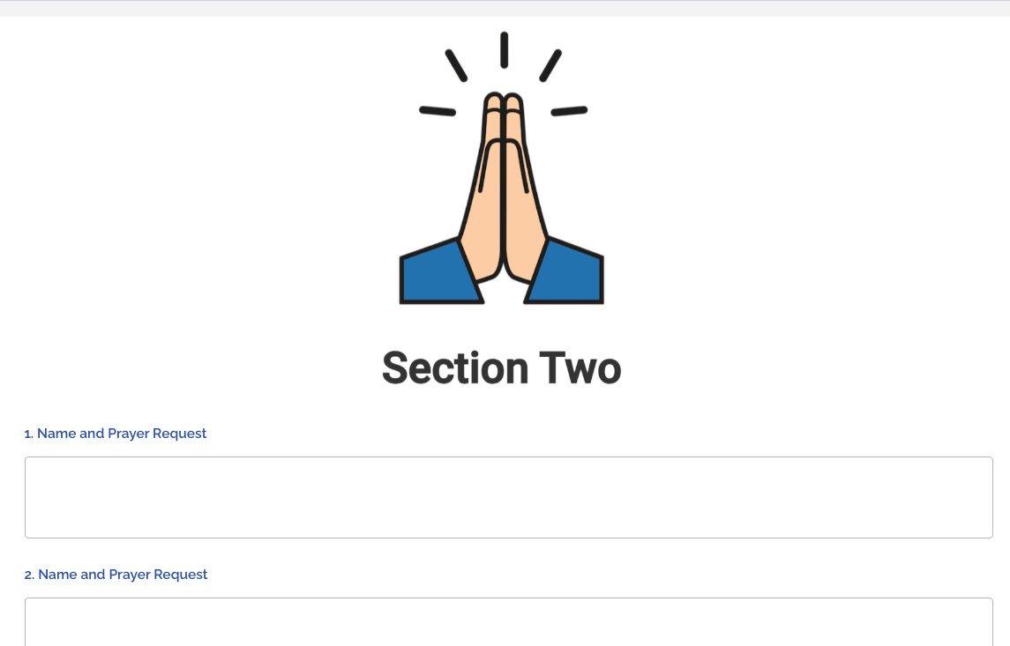
Actual Study Demonstration – Prayer Logs
Notes:
Finish each class sharing answers to prior prayer requests (praises glorify God) and taking new prayer requests
Encourage every participant to pray daily for every member in the group throughout the study

Slide 39
Set Your House In Order
Tips & Tools

Slide 40

Financial Discipleship Study Tools
  QR codes in the print version link directly to the study videos.
  Electronic application worksheets
    Calculations are automatic
    Examples of completed applications
  Howard’s Highlights in each module
  Memory verse tools
  Online calculators
Notes:
These tools are available to assist you during the study.

Slide 41
Compass Tools for Demonstration
DEMO Compasstools.org

Slide 42
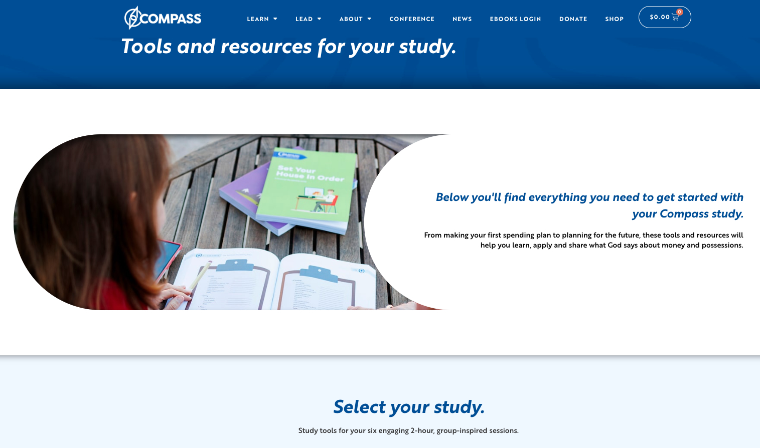
Compass Tools Demonstration
Notes:
Compasstool.org will take you to this page and you will scroll down the page.

Slide 43
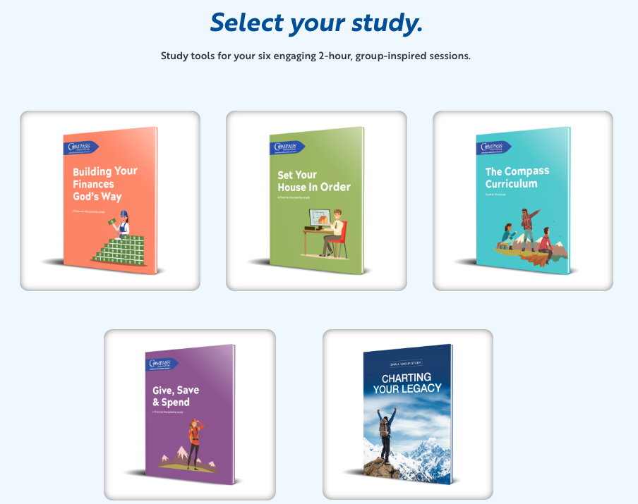
Compass Tools Demonstration
Notes:
Click on SYHIO.

Slide 44
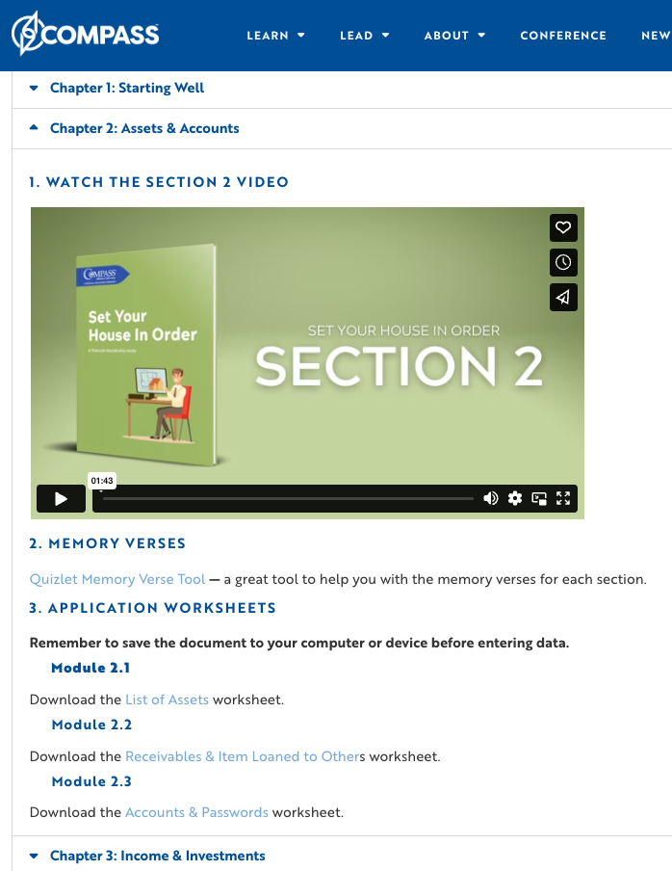
Compass Tools Demonstration
Notes:
You can access each section and modules memory verses, videos, worksheets, etc.

Slide 45
Set Your House In Order
Section 1- Homework Assignment

Slide 46
Preparation For Section One
(Month, Date, Year)
Read and complete Section 1, Modules 1, 2 & 3
Memorize the Day 1 memory verse: Proverbs 16:3 (ESV) – “Commit your work to the Lord, and your plans will be established.”
Read the scriptures associated with each module and record your answers
Read Howard’s Highlights
Complete the practical applications associated with Module 1 (The Asset Worksheet)
Record your prayer request that you would like to share at the end of the class.
Notes:
Review the first sessions activities.

Slide 47
Class Agenda
Start and end on time
Open the group discussion in prayer
Everyone individually recites the scripture memory verse from the version used in the financial discipleship study
If you have not completed the homework, we ask that you join the session, but not respond to the questions
Conduct the group discussion
Review the homework for the next meeting
Share prayer requests through the App or in the “Prayer Log”
Have one person close in prayer
Notes:
Review how each session will flow.

Slide 48

Questions
Co-Leaders Name:
Email Address
Phone Number
Co-Leaders Name:
Email Address
Phone Number
Notes:
Add each Co-leaders name, email address and phone number.
Answer questions from the participants.

