Slide 1
INTRODUCING:
Insert company logo
TEACHING CHILDREN
Concepts and portions of this text have been taken from the
Charting Your Legacy Study and the Building Your Finances God’s Way Study by Howard Dayton, Copyright 2017.

Slide 2


Being an MVP Parent & Grandparent

Slide 3


Paul Finished Well
Model
“Be imitators of me,
just as I also am of Christ.”
- 1 Corinthians 11:1
“Everyone, when he has been
fully trained,
will be like his teacher.”
– Luke 16:40
Notes:
MODELING
Since children soak up parental attitudes toward money like a sponge soaks up water, parents must model handling money wisely. Paul recognized the importance of modeling when he said, “Be imitators of me, just as I also am of Christ” (1 Corinthians 11:1).
Luke 6:40 is a challenging passage. It reads, “. . . Everyone, when he has been fully trained, will be like his teacher.” Another way of saying this is that we can teach what we believe, but we only reproduce who we are. There is no substitute for parents being good models.

Slide 4

Finishing Well is Difficult
Verbalize
“These words, which I am commanding you today, shall be on your heart. You shall repeat them diligently to your sons and speak of them when you sit in your house, when you walk on the road, when you lie down, and when you get up”
- Deuteronomy 6:6-7
Notes:
VERBAL COMMUNICATION
Parents need to tell their children why they are handling money the way they are. The Lord charged the Israelites, “These words, which I am commanding you today, shall be on your heart. You shall repeat them diligently to your sons and speak of them when you sit in your house, when you walk on the road, when you lie down, and when you get up” (Deuteronomy 6:6-7). We must verbally instruct children in the ways of the Lord, but children need more than a good example and verbal instruction; they also need practical experience.

Slide 5
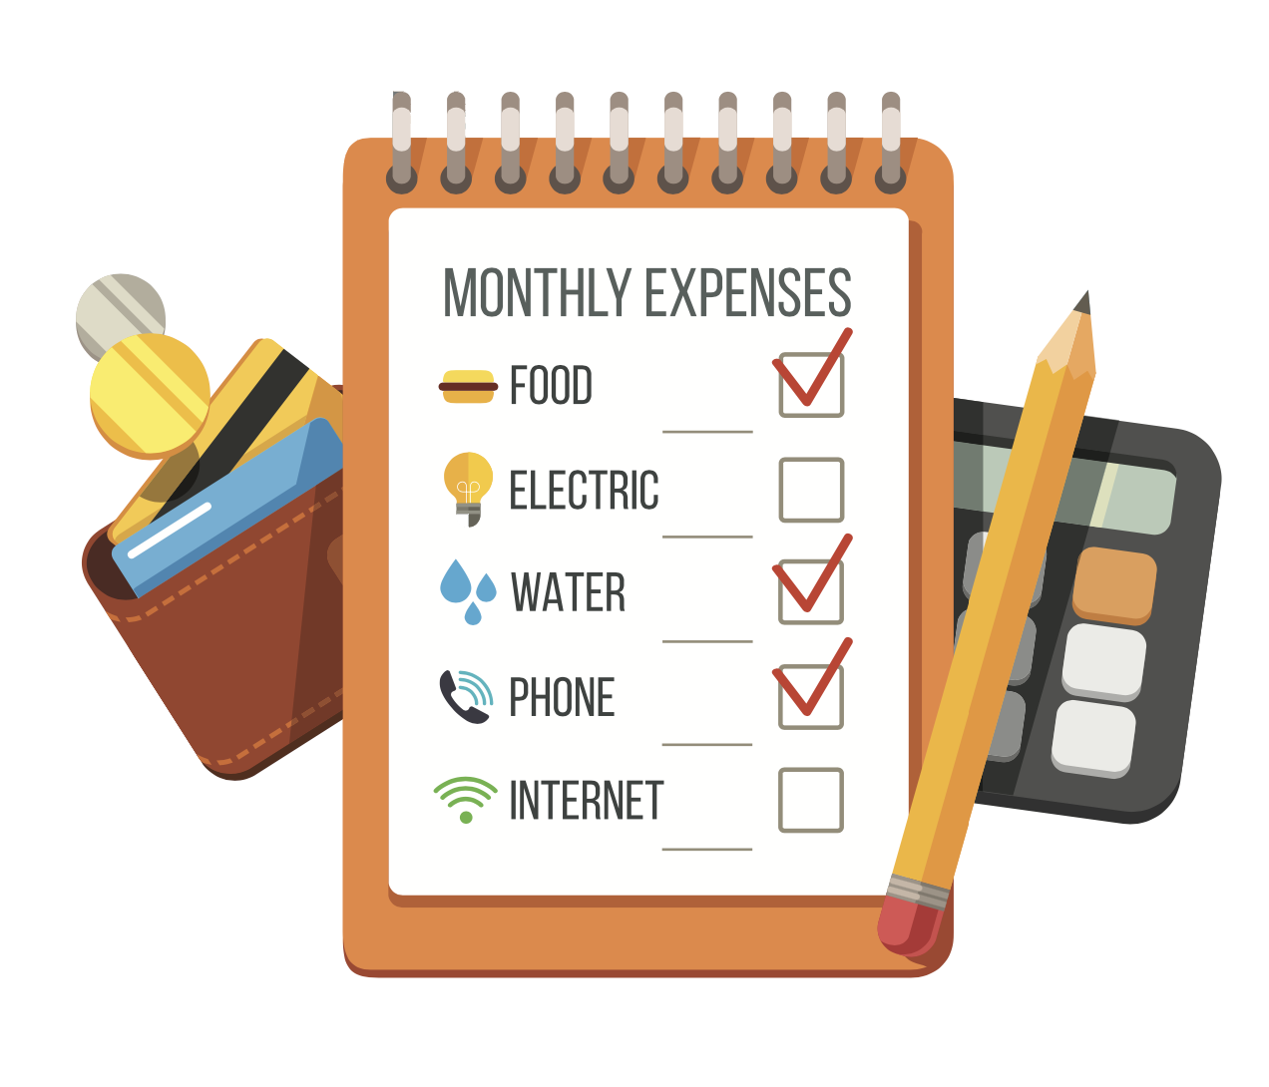
Verbalize
Verbalize
Share Your Spending Plan

Slide 6

Finishing Well is Difficult
Verbalize
Share Your
Savings Plan
Notes:
Share also how you make decisions and what your process to purchasing and prioritizing these items are; vacations, cars, homes, etc.

Slide 7
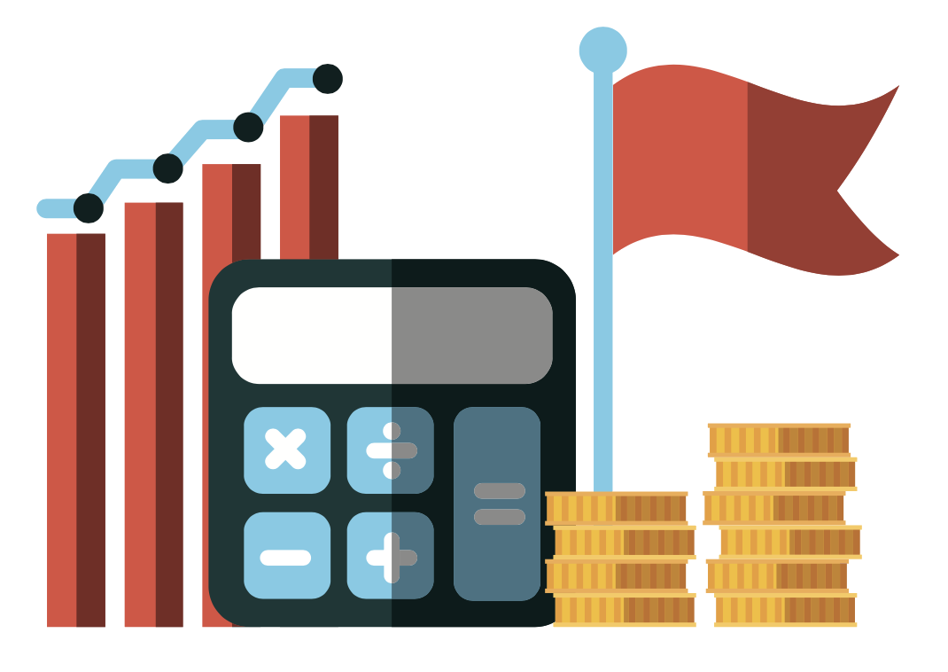
Finishing Well is Difficult
Verbalize
Share Your
Giving Plan

Slide 8

Verbalize
Share Your
Financial Setbacks

Slide 9

Finishing Well is Difficult
Practical Experience
There are money-management and money-making learning experiences that benefit children of all ages.
Notes:
There are money-management and money-making learning experiences that benefit children.
Teaching money management must not just be delegated to teachers. Parents must also seize the opportunity because spending experiences are found outside the classroom. Consider five areas where this is possible.

Slide 10
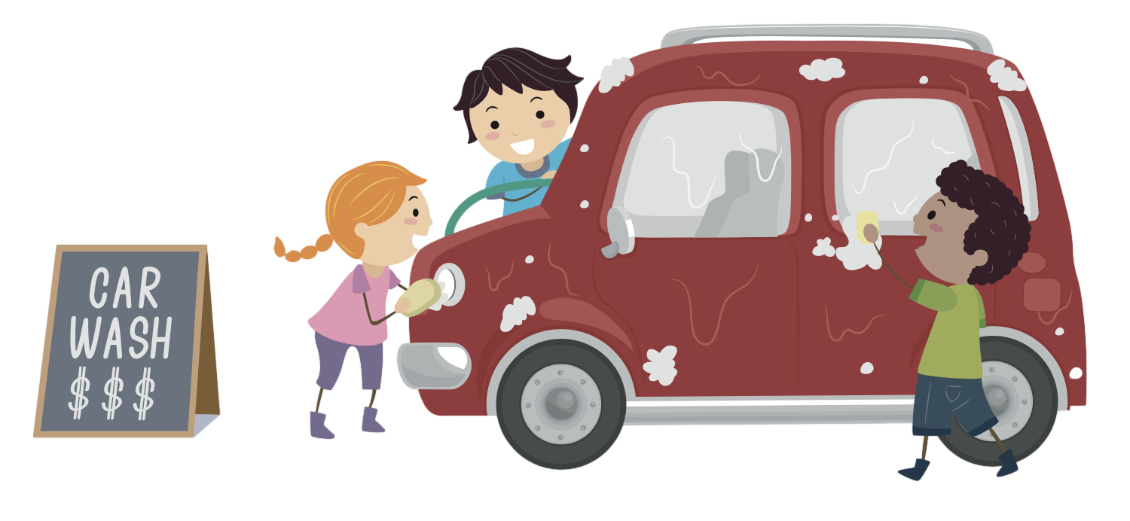
Finishing Well is Difficult
1. Money Management Experiences
Receiving and
managing income.
Notes:
INCOME As soon as children are ready for school, they should begin to receive an income to manage. Parents need to decide whether the child must earn an income or whether they wish to give an allowance in return for the child doing chores.
The amount of the income will vary according to factors such as the child’s age, the ability to earn, and the financial circumstances of the family. The amount, however, isn’t as important as the responsibility of handling money. At first, as with any new experience, the child will make many mistakes. When this happens, don’t hesitate to let the “law of natural consequences” run its course. Yes, you will be tempted to help when the child spends all the income the first day on an unwise purchase. But don’t bail the child out! Mistakes will be the best teacher.
Parents should establish boundaries and offer advice on how to spend money, but your child must have freedom of choice within these boundaries. Every Saturday I used to bicycle to the store with my son, Matthew, to buy him a pack of gum. Despite my advice, the entire pack would be consumed that day.
When he started to earn money, we decided that Matthew would have to buy his own gum. I will never forget the expression on his face as he came out of the store with his first purchase. “This gum cost me all my money!” he yelled. That pack of gum lasted all week.

Slide 11
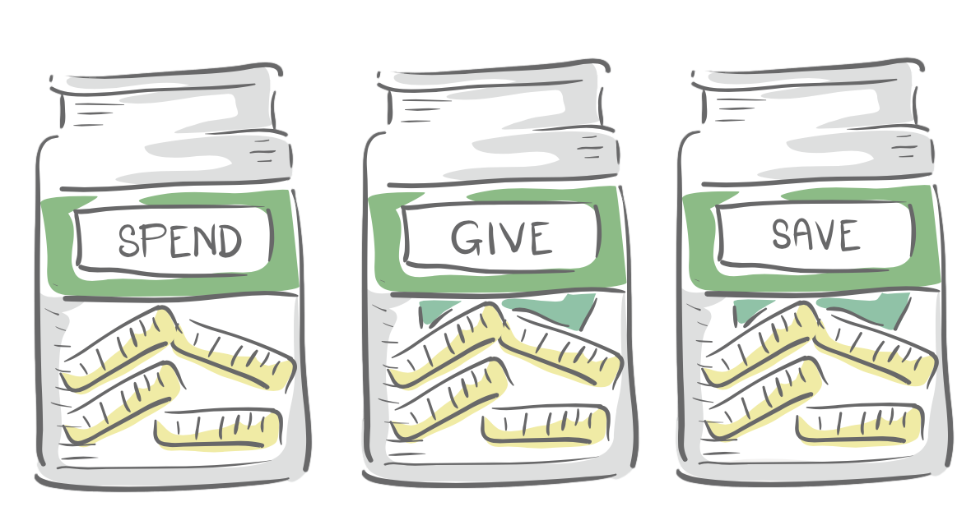
Finishing Well is Difficult
2. Money Management Experiences
Learning to Budget
Notes:
When children start to receive an income, teach them to budget. Begin with a simple system consisting of three jars, labeled separately: GIVE, SAVE, and SPEND. The child distributes a portion of the income into each jar. Even a six-year-old can understand this method, because when the spend jar is empty, there’s no more money to spend!
When children become teenagers, they should begin using a written budget — or train them to use one of the budgeting software or online programs that are available. During the training, teach shopping skills, the ability to distinguish needs from wants, and the importance of waiting on the Lord to provide. Warn him or her about the danger of impulse spending.
One valuable lesson you can teach children is to seek the Lord’s provision through prayer. We often rob ourselves of this opportunity by buying things or charging purchases without praying for the Lord to supply them.

Slide 12

Finishing Well is Difficult
3. Money Management Experiences
Saving & Investing
Notes:
SAVING AND INVESTING
The habit of saving should begin as soon as the child receives an income. As children mature, expose them to various types of investments: stocks, bonds, etc. Also, teach children the benefits of compounding interest. If they grasp this concept and become faithful savers, they will enjoy financial stability as adults. Parents should demonstrate this by saving for something that will directly benefit the children. Use a graph the children can fill in so they can visually chart the progress of saving.
Children should have both short-term and long-term saving goals. The younger the child, the more important the short-term goals are. To a four-year-old, a week seems like a lifetime to save for a purchase. They won’t understand saving for their future education, but they will get excited about saving for a small toy.
This is also a great opportunity to open a savings or investment account with your child and to review it regularly to see and celebrate how much they are saving/investing.

Slide 13
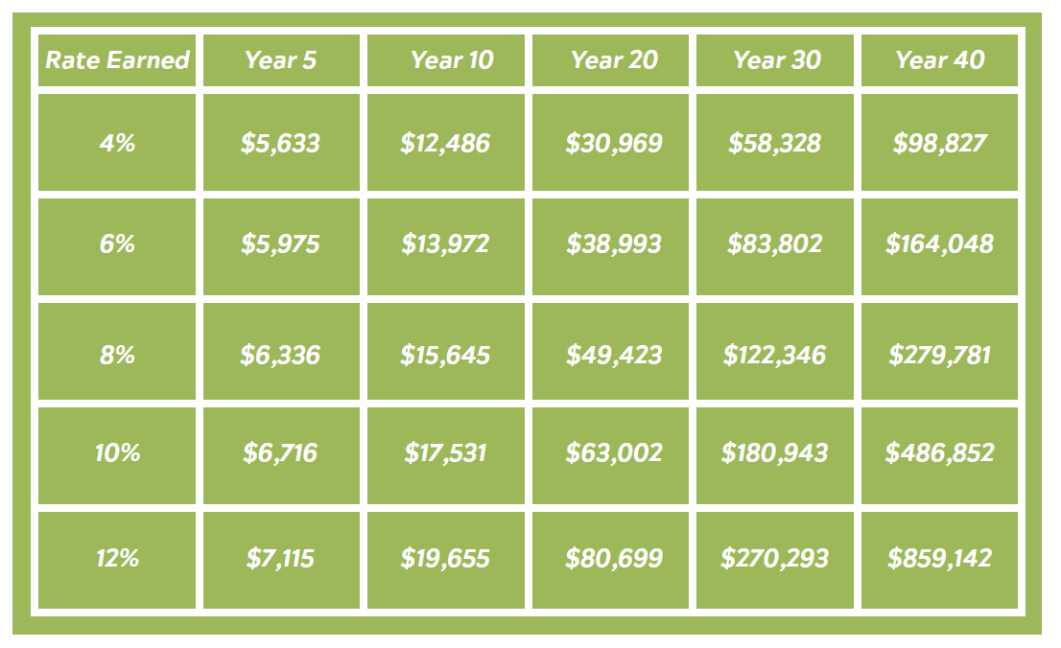
Finishing Well is Difficult
3. Explaining Compound Interest
Notes:
There are three variables in compounding: the amount you save, the percentage rate you earn, and the length of time you save.
THE AMOUNT The amount you save depends on your income and spending. We hope you will increase the amount available for saving as you learn God’s way of handling money.
RATE OF RETURN The second variable is the rate you earn on an investment. The following table demonstrates how an investment of $1,000 a year grows at various rates.
As you can see, an increase in rate has a remarkable effect on the amount accumulated. A two percent increase almost doubles the total over 40 years. But since higher returns usually also carry higher risks, be careful not to shoot for unrealistic returns.
TIME Time is the third factor. Answer this: Who would accumulate more by age 65: Danielle who started saving $1,000 a year at age 21, saved for eight years, and then completely stopped; or Matt who saved $1,000 a year for 37 years starting at age 29? Both earned 10 percent. Is it Danielle who saved a total of $8,000 or Matt who saved $37,000? Incredibly, Danielle accumulated more because of the earlier start. Compounding is your friend, and the earlier you can start it working for you, the better. Start saving and investing today!

Slide 14

Finishing Well is Difficult
4. Money Management Experiences
Avoiding Debt
Notes:
DEBT
Also teach how difficult it is to get out of debt. A father loaned his son and daughter money to buy bicycles. He drew up a credit agreement with a schedule for repayment of the loan including interest. After they went through the long process of paying off the loan, the family celebrated with a “mortgage burning” ceremony. The children appreciated those bikes more than any of their possessions. They also decided to avoid debt in the future.

Slide 15
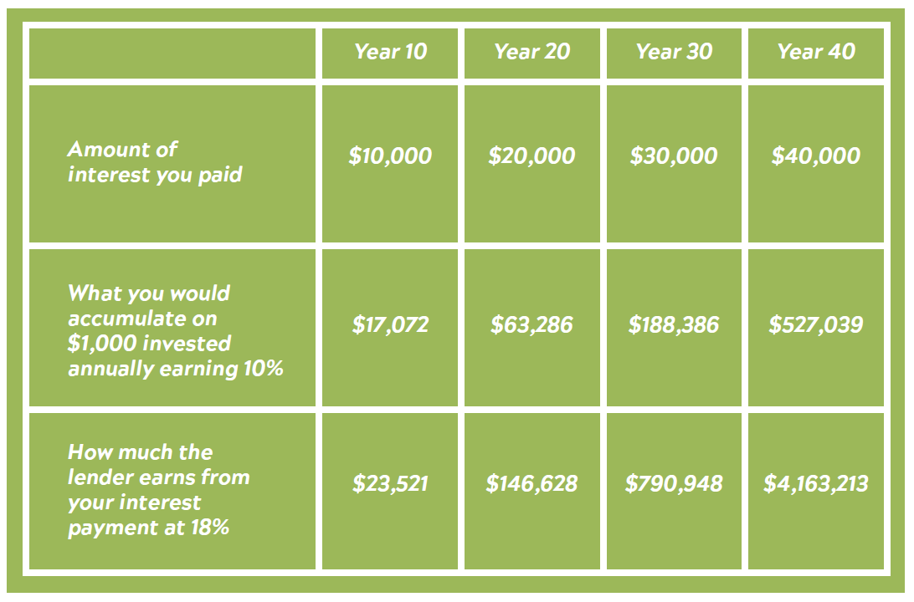
4. Explaining what debt really costs . . .
Notes:
DEBT
We need to understand the real cost of debt. Assume you have $5,560 in credit card debt at an 18 percent interest rate. This would cost you $1,000 in interest annually. Check out the chart above.
You can see what lenders have known for a long time: the eye-popping impact of compounding interest working for them. If they earn 18 percent, they will accumulate more than $4 million on your $1,000 a year for 40 years! Is it any wonder credit card companies are eager for you to become one of their borrowers?
Now compare the $40,000 you paid in interest over 40 years with the $527,039 you would have accumulated if you earned 10 percent on $1,000 each year. The monthly income on $527,039 earning 10 percent — without ever touching the principal — is $4,392!
Debt has a much higher cost than many realize. Stop to consider this: When you assume debt of $5,560 and pay $1,000 a year in interest versus earning a 10 percent return on that $1000, it actually costs you $527,039 over 40 years. The next time you find yourself tempted to purchase something with debt, ask yourself if the long-term benefits of staying out of debt outweigh the short-term benefits of the purchase.

Slide 16

Finishing Well is Difficult
5. Money Management Experiences
Establishing the habit of giving.
Notes:
GIVING
The best time to establish the habit of giving is when you’re young. It’s helpful for children to give a portion of their gifts to a need they can see. For example, a child understands when the gift helps to buy food for a needy family he actually knows.
Richard Halverson, the late U. S. Senate chaplain, gave his son, Chris, this heritage as a child. Chris gave money to support Kim, an orphan who had lost his sight during the Korean War. Chris was taught to feel that Kim was like an adopted brother. One Christmas, Chris bought Kim a harmonica. Kim cherished this gift from Chris and learned to play it well. As the years went by Kim became an evangelist, and his presentation of the gospel included playing the harmonica.
Find out what your kid’s passions are as it relates to giving and help them see where they can give to that passion.
When your child is a teenager, serving at the local homeless shelter or taking a mission trip to a developing country can be a powerful experience. Exposure to poverty can initiate a lifetime of giving to the needy. We also recommend a family time each week for dedicating that week’s gifts to the Lord.

Slide 17
5. Giving should be . . .
Periodic
Personal
Private Deposit
Priority
Premeditated
Notes:
GIVING
Giving should be periodic. “On the first day of every week . . .” The Lord understands that we need to give frequently. Giving only once a year is a mistake. We need to give regularly to be drawn consistently to Christ.
Giving should be personal. “Each of you is to . . .” It is the responsibility of every child of God, whether young or old, rich or poor, to give. The advantages of giving are intended for each person, and each one must participate to enjoy them to the full.
Giving should be out of a private deposit. “Put aside and save . . .” If you experience difficulty in monitoring the money you have decided to give, consider opening a separate account or setting aside a special “cookie jar” into which you deposit the money you intend to give. Then, as needs are brought to your attention, the money is ready to meet those needs.
Giving should be a priority. “Honor the Lord from your wealth, and from the first of all your produce” (Proverbs 3:9, emphasis added). As soon as we receive any income, we should set aside the amount we are going to give. This habit helps us to put Christ first in all we do — and defeats the temptation to spend what we have decided to give.
Giving should be premeditated. “Each one must do just as he has decided in his heart” (2 Corinthians 9:7). We should give prayerfully, exercising the same care in selecting where we give as we do when deciding where to invest.

Slide 18
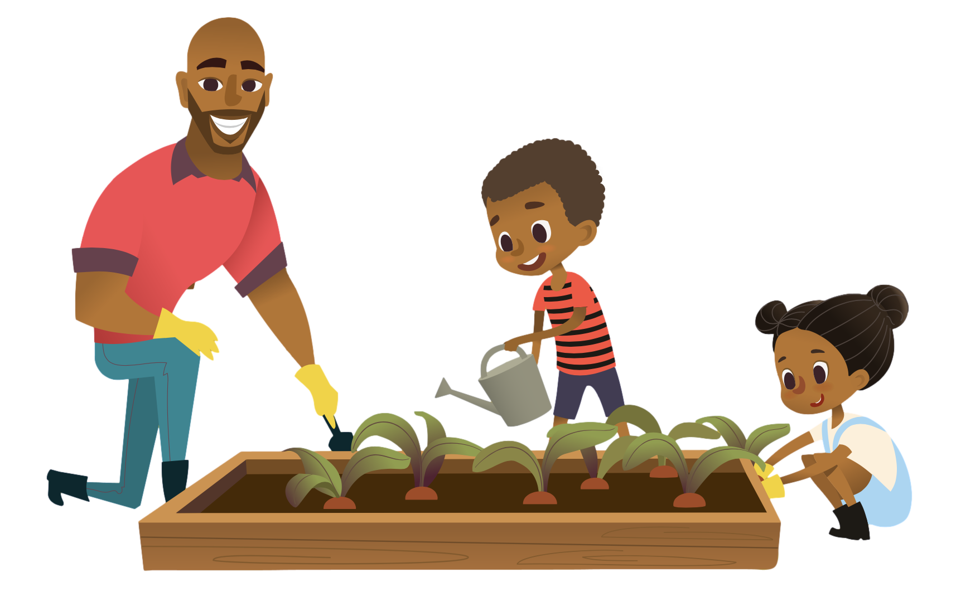
Developing Work Habits
Parents also have a responsibility
to train children to develop work habits.
Notes:
Parents also have a responsibility to train children to develop work habits.
If children learn how to work with the proper attitude, they will have taken a giant step toward becoming valuable in the job market.
There are three areas to consider in this training:
LEARNING ROUTINE RESPONSIBILITIES
One of the best ways for a child to become a faithful worker is to establish the habit of daily household chores. These are tasks that each member of the family is expected to perform.

Slide 19
Finishing Well is Difficult
1. Routine Responsibilities
Notes:
LEARNING ROUTINE RESPONSIBILITIES
One of the best ways for a child to become a faithful worker is to establish the habit of daily household chores. These are tasks that each member of the family is expected to perform.

Slide 20

2. Expose Children to Your Work
Notes:
EXPOSE CHILDREN TO YOUR WORK
Many children have no idea how their father or mother earns an income. An important way to teach the value of work is to expose children to the parents’ means of making a living.
One word of advice: Because most children are no longer with their parents at work, parents’ work habits around the home will be a major influence. If a parent works hard away from home but complains about washing the dishes at home, what’s being communicated to the children? Examine your attitudes when working around the house to ensure that your children see a good example.

Slide 21

Finishing Well is Difficult
3. Getting a Part-Time Job
Notes:
WORKING FOR OTHERS
Babysitting, bagging groceries, delivering pizza or waiting on tables will be an education. A job gives a child an opportunity to enter into an employee-employer relationship and to earn extra money. The objective of teaching children the value of work is to build character. A working child with the proper attitude will be a more satisfied individual. He or she will grow up with more respect for the value of money and the effort required to earn it.

Slide 22

Finishing Well is Difficult
Funding College Education
Creating a Partnership

Slide 23
Funding College Education
What parents will do.
What children will do.
Notes:
Parents
Set specific expectations of how you will help provide for education (examples):
Will pay for four years of college, anything beyond that is the child’s financial responsibility.
Children
Will have a spending plan of how they will use money they receive for college.
Will pay back parents for any failed courses or grades below expectations.

Slide 24

Finishing Well is Difficult
Adult Children & Grandkids
Assisting adult
children and
their families.
Notes:
My wife and I decided the wisest way to financially assist our children and their future spouses was to help them pay off their home mortgages. This would enable them to eliminate their largest monthly expense and focus on becoming more generous and more efficient in their saving and investing.
When my daughter and her husband bought their “fixer upper” first home, we matched whatever they prepaid on the home mortgage. They caught the vision for paying off their home and faithfully put whatever they could toward pre-paying on their mortgage. With their faithfulness and our matching gift, they were able to pay their home off in under five years.
We believe in helping our adult children to live in a mortgage-free home instead of giving them gifts that increase their lifestyle. We have also encouraged them to consider “paying it forward” to their children by duplicating this strategy.
If you are a grandparent, you have a wonderful opportunity to influence your grandchildren. Too often parents and grandparents have not reached agreement on how to train the next generation. This can lead to bruised relationships and ineffective training. It’s important for grandparents to play a role in which they complement the objectives of the parents. We recommend that parents meet with grandparents and together design a strategy for training the grandchildren how to handle money.

Slide 25

Tools for the Journey . . .
Ages 5-10 - The Treasure Hunt
Ages 11-15 – New Study Coming Soon!
Ages 16-22- Give, Save & Spend Study
Adult Children- The Build Study

Slide 26

NEXT STEPS

Slide 27


Compass1.org/advisortools

